Slide 1
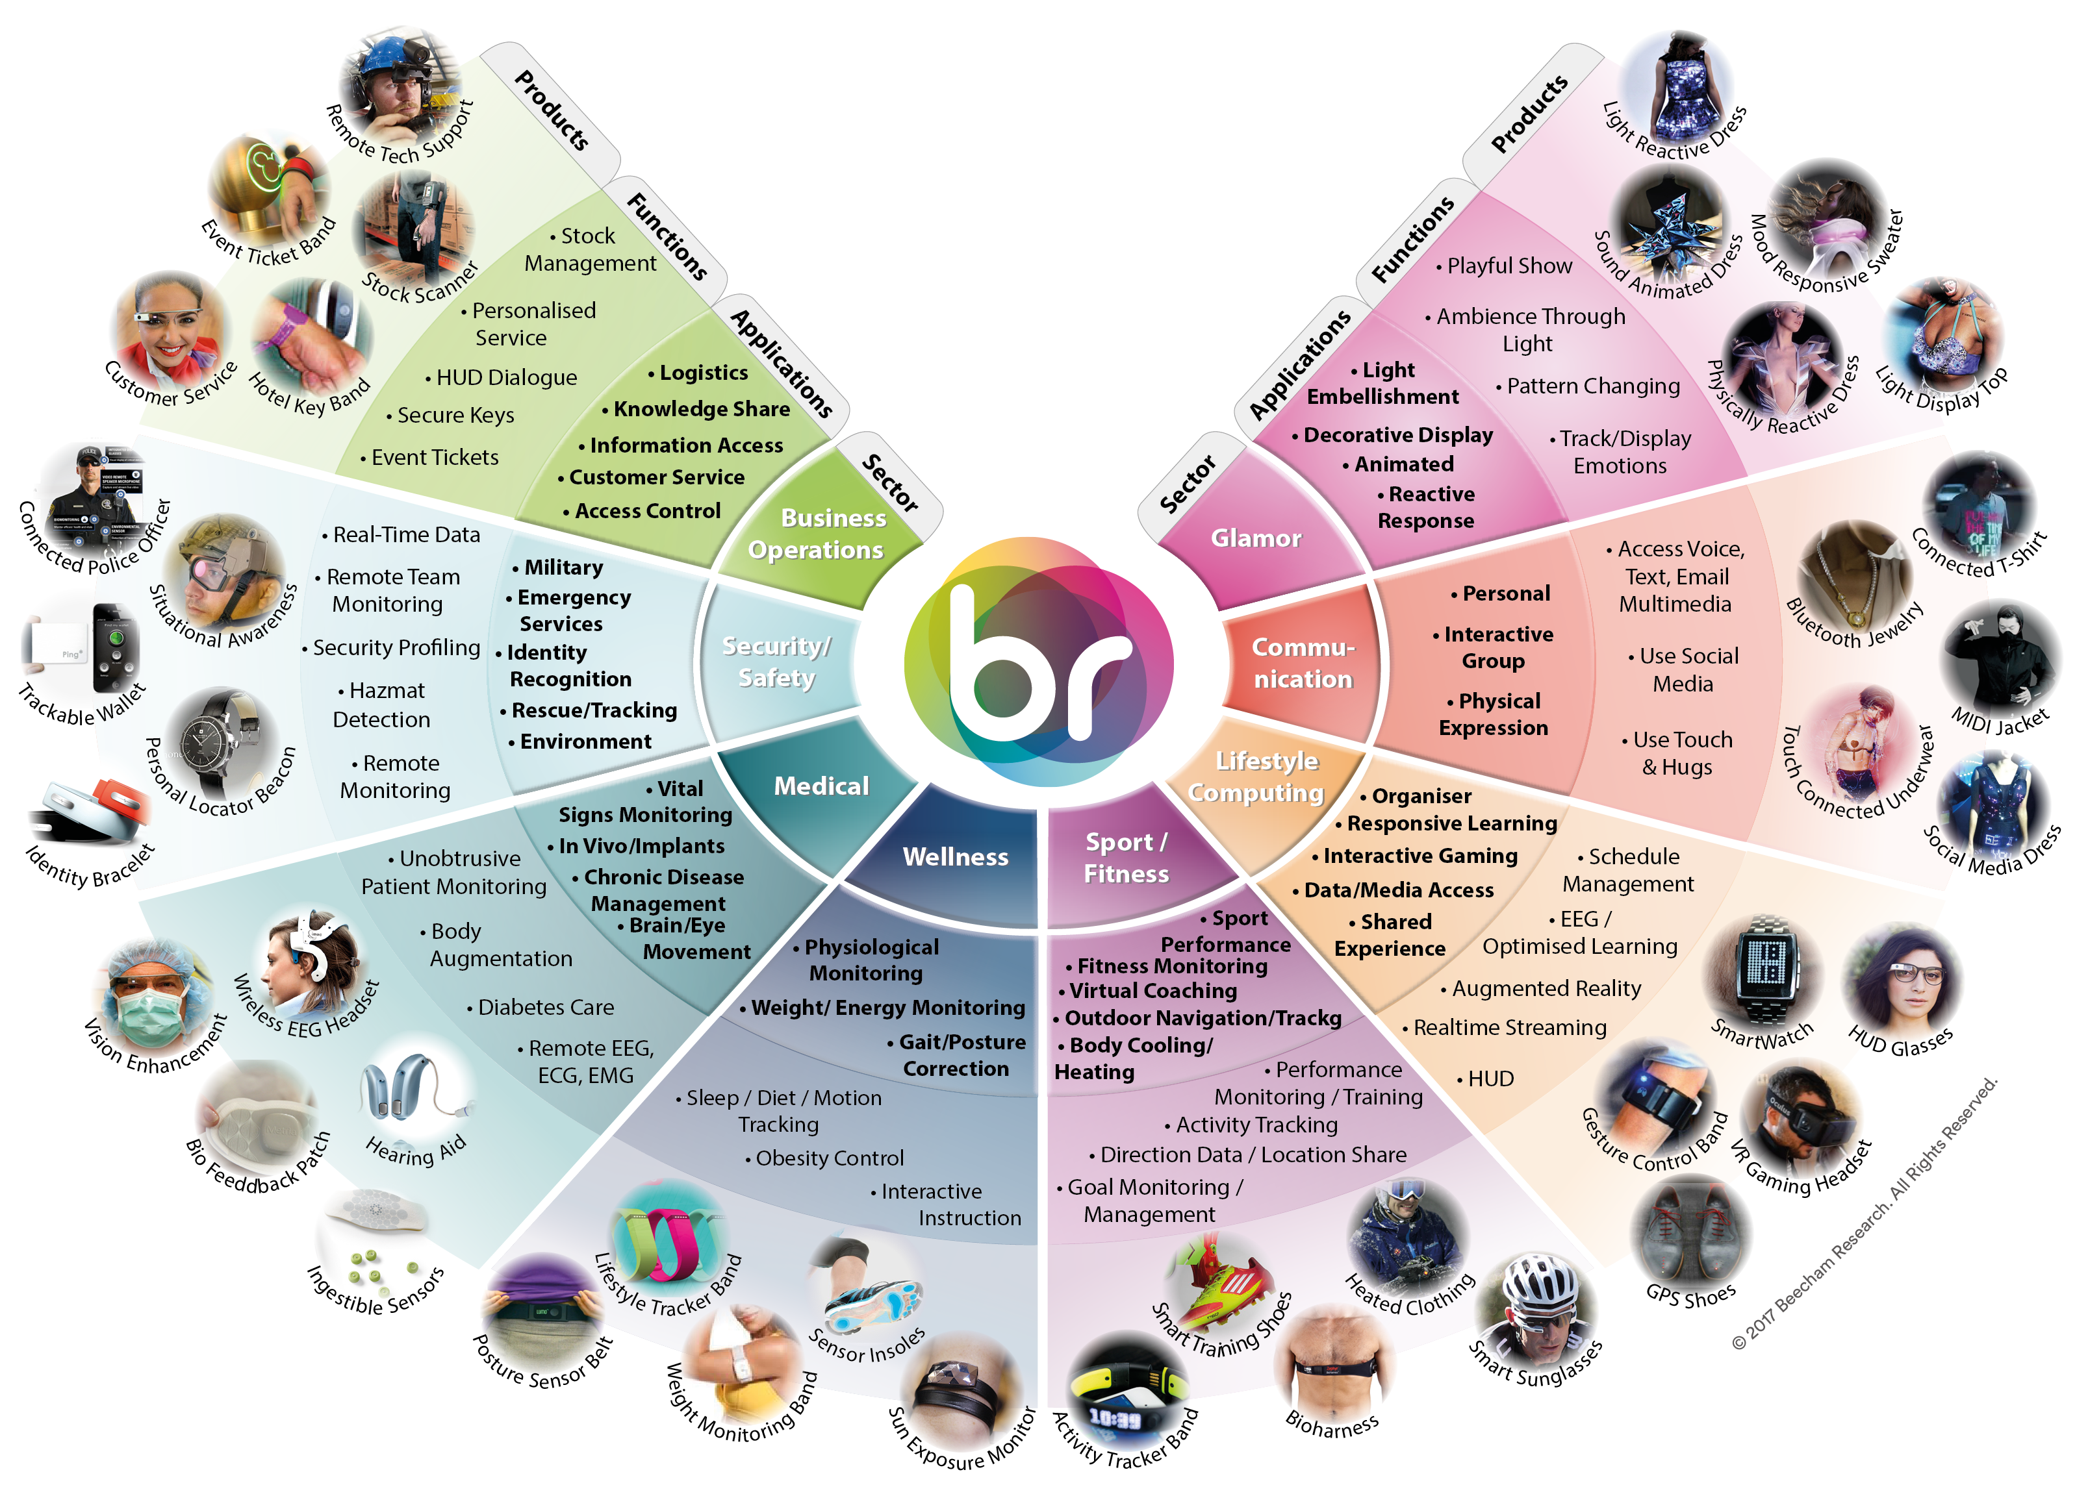
World of Wearable Technology Applications
Towards Function with Style

